Slide 1
DR Kottnis Hospital
Muhammad Ahsan Ali 233569
Muhammad Jawad 233557

Slide 2
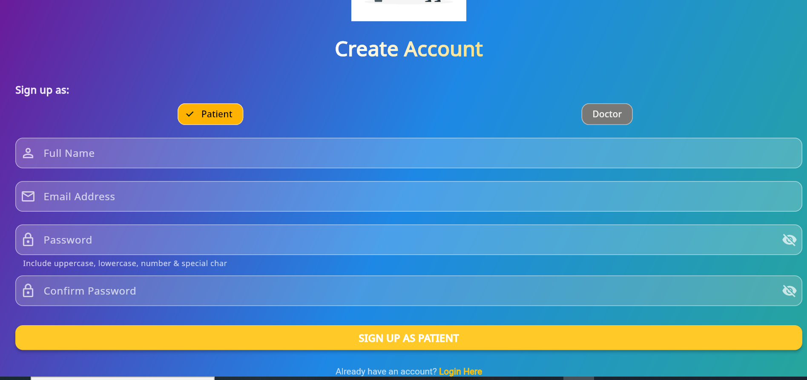
Register as a patient

Slide 3
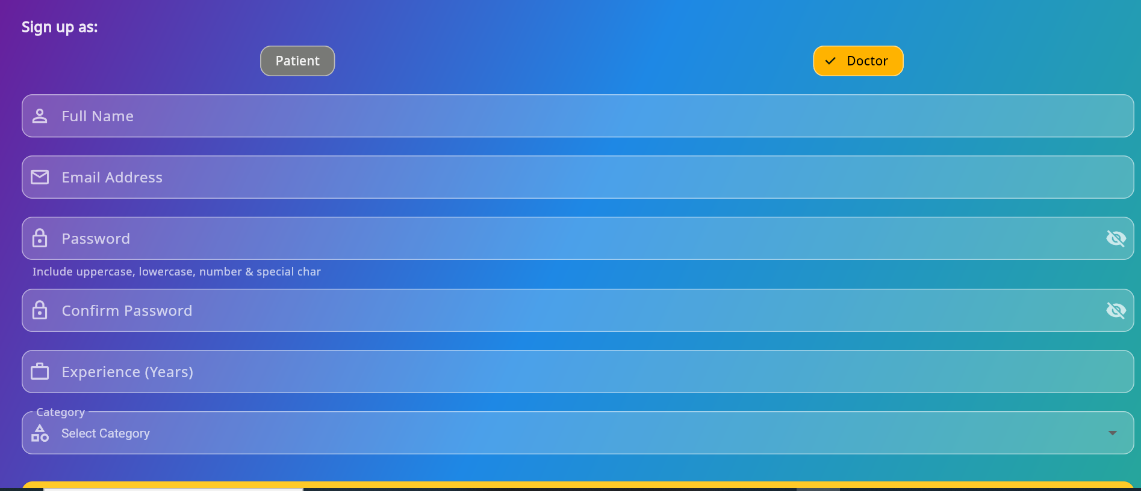
Register as a Doctor

Slide 4
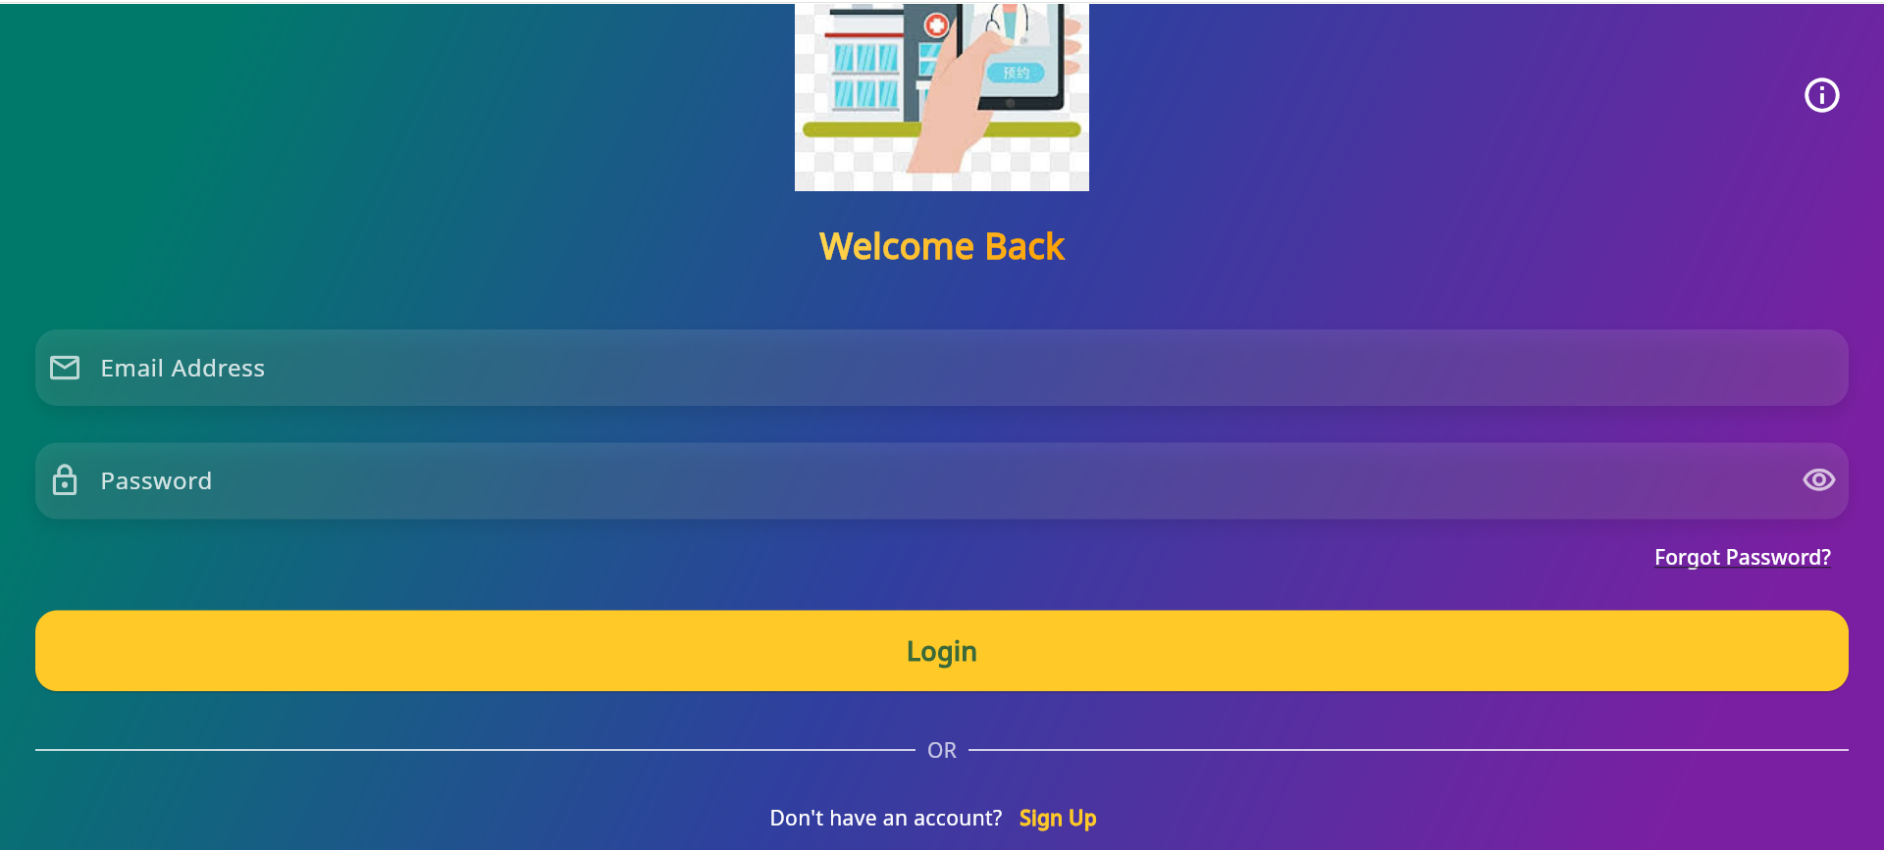
Login page

Slide 5
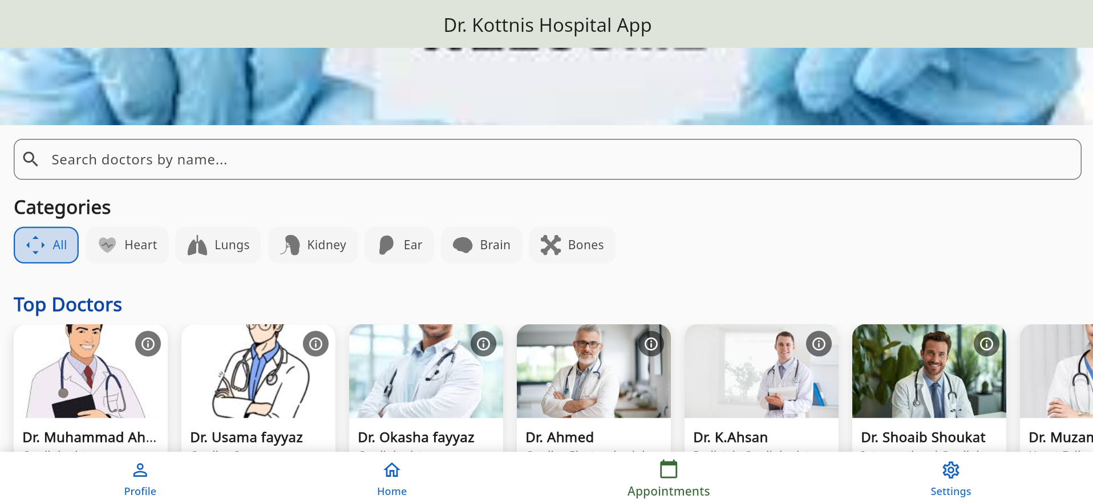
User Home Screen page

Slide 6
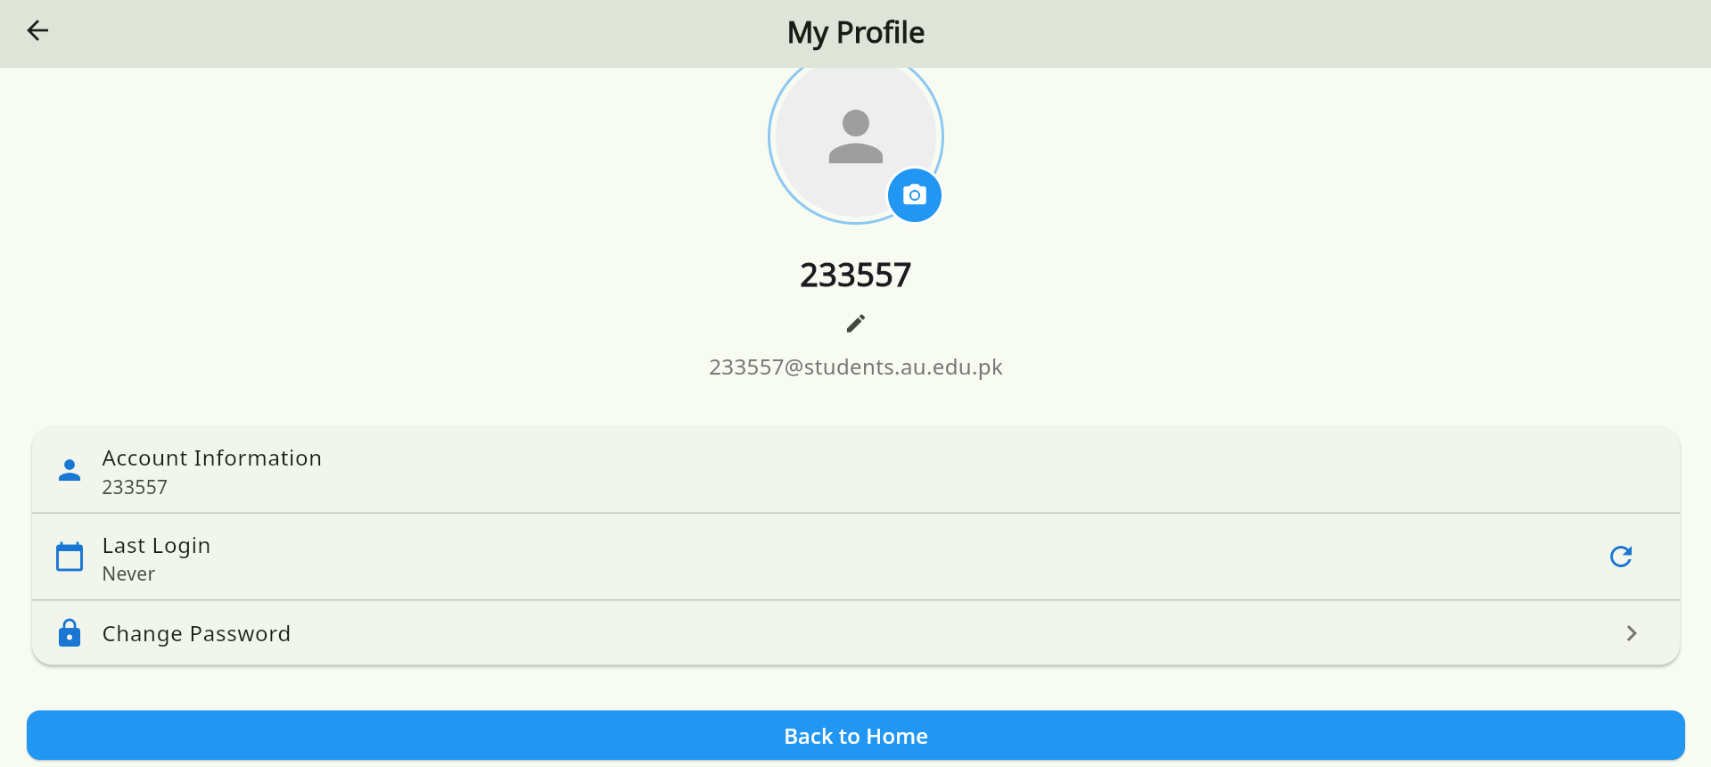
User Profile

Slide 7
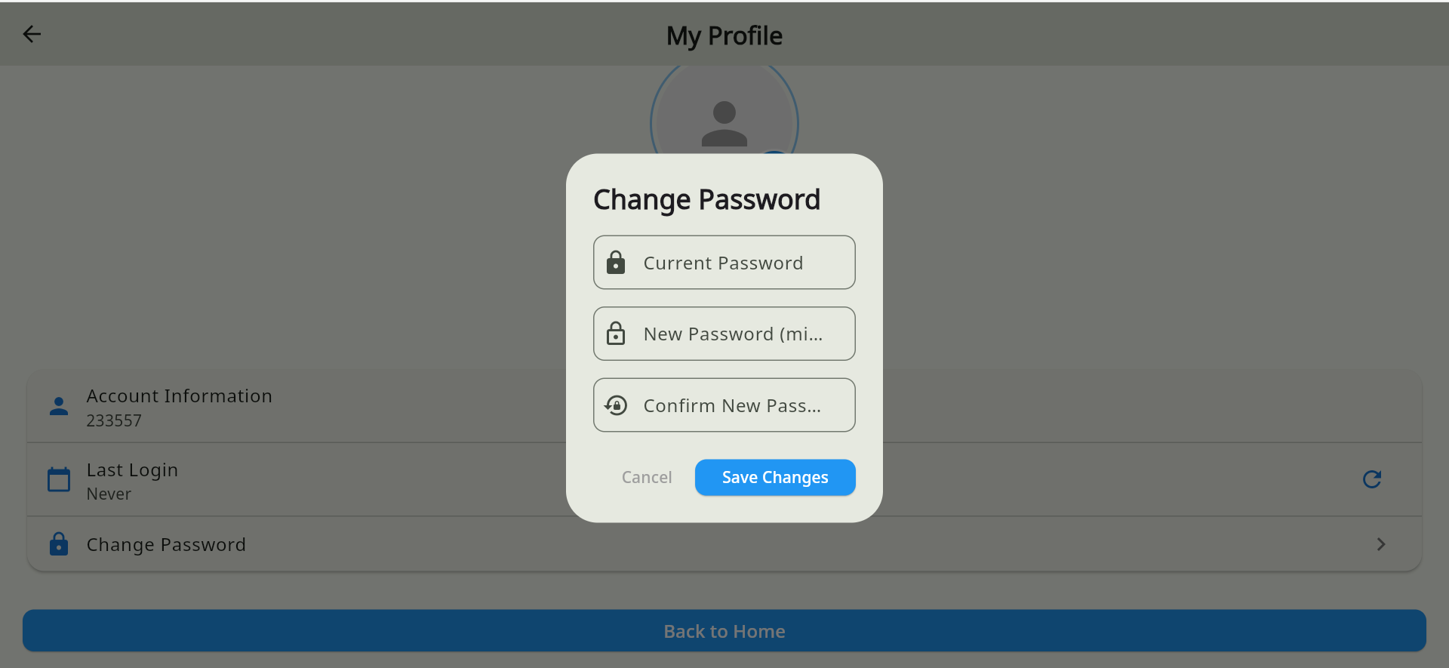
Change password

Slide 8
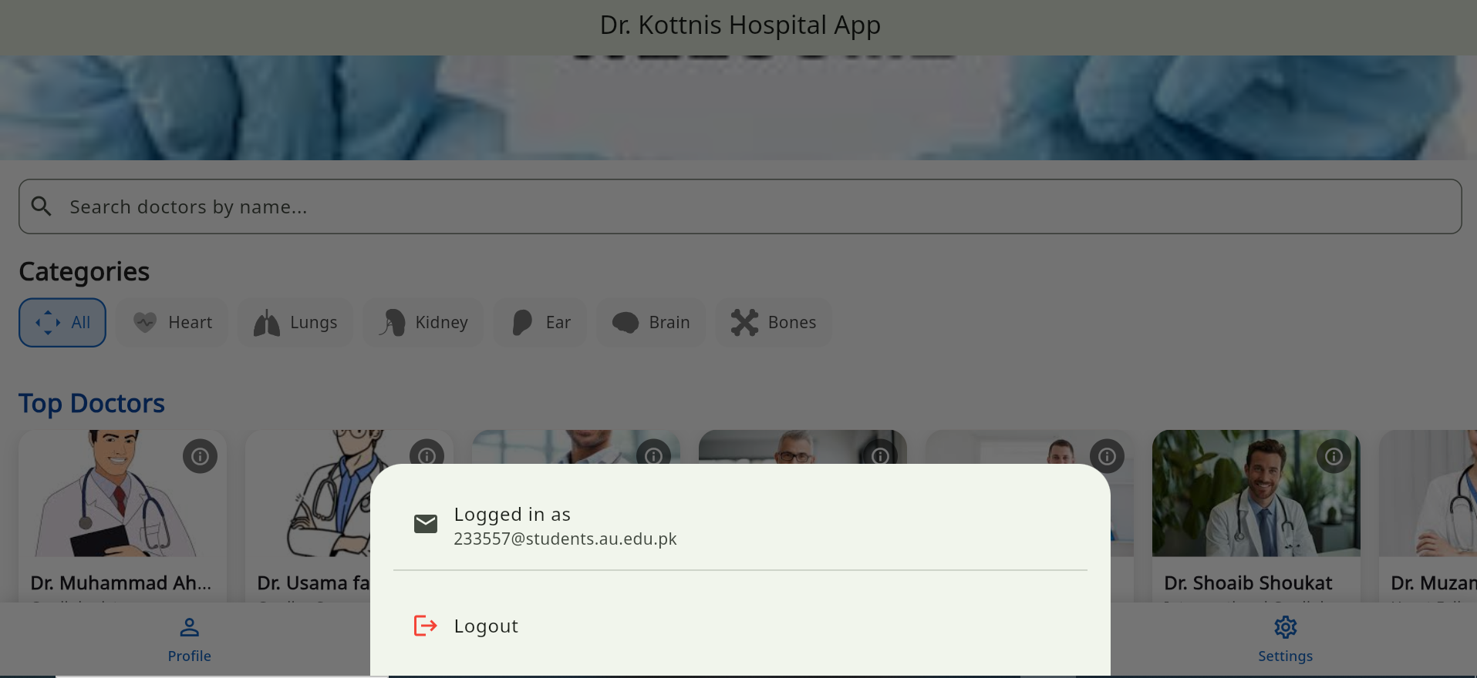
Logout option in menu

Slide 9
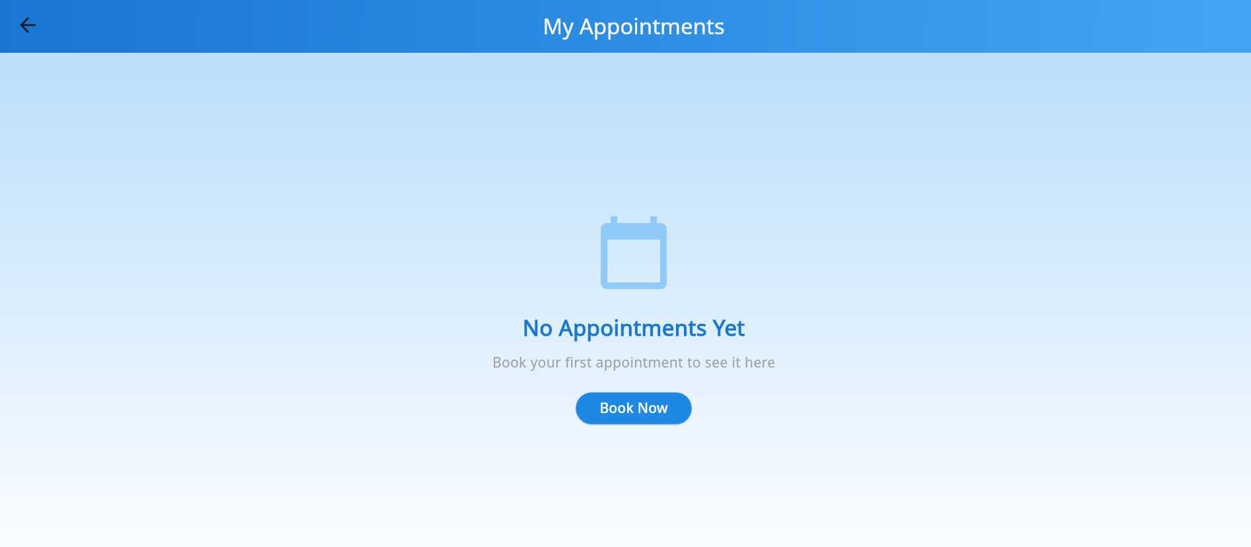
User Appointment Screen

Slide 10
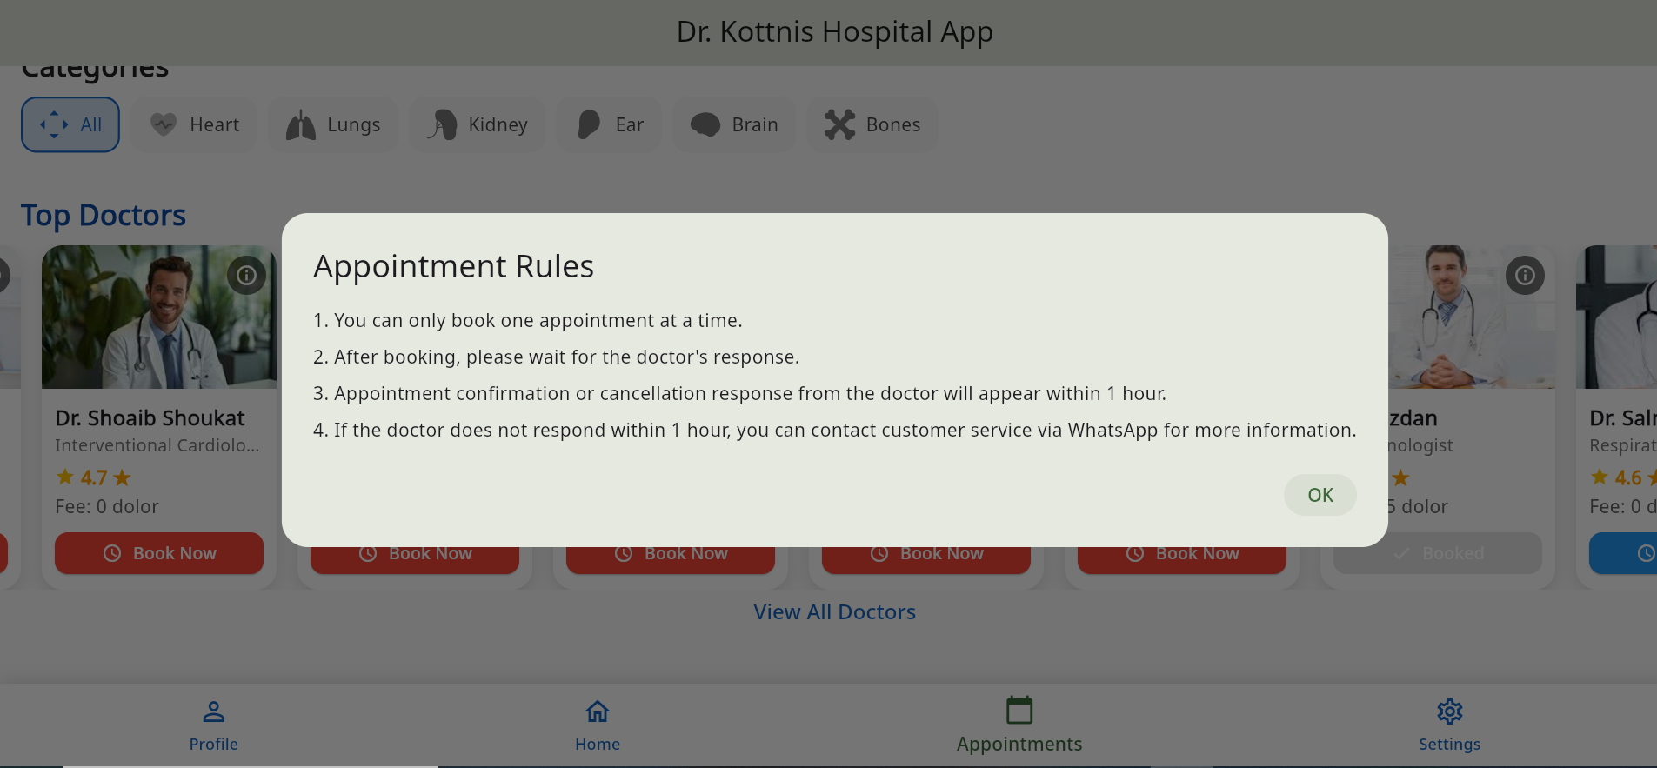
Appoinment rules

Slide 11
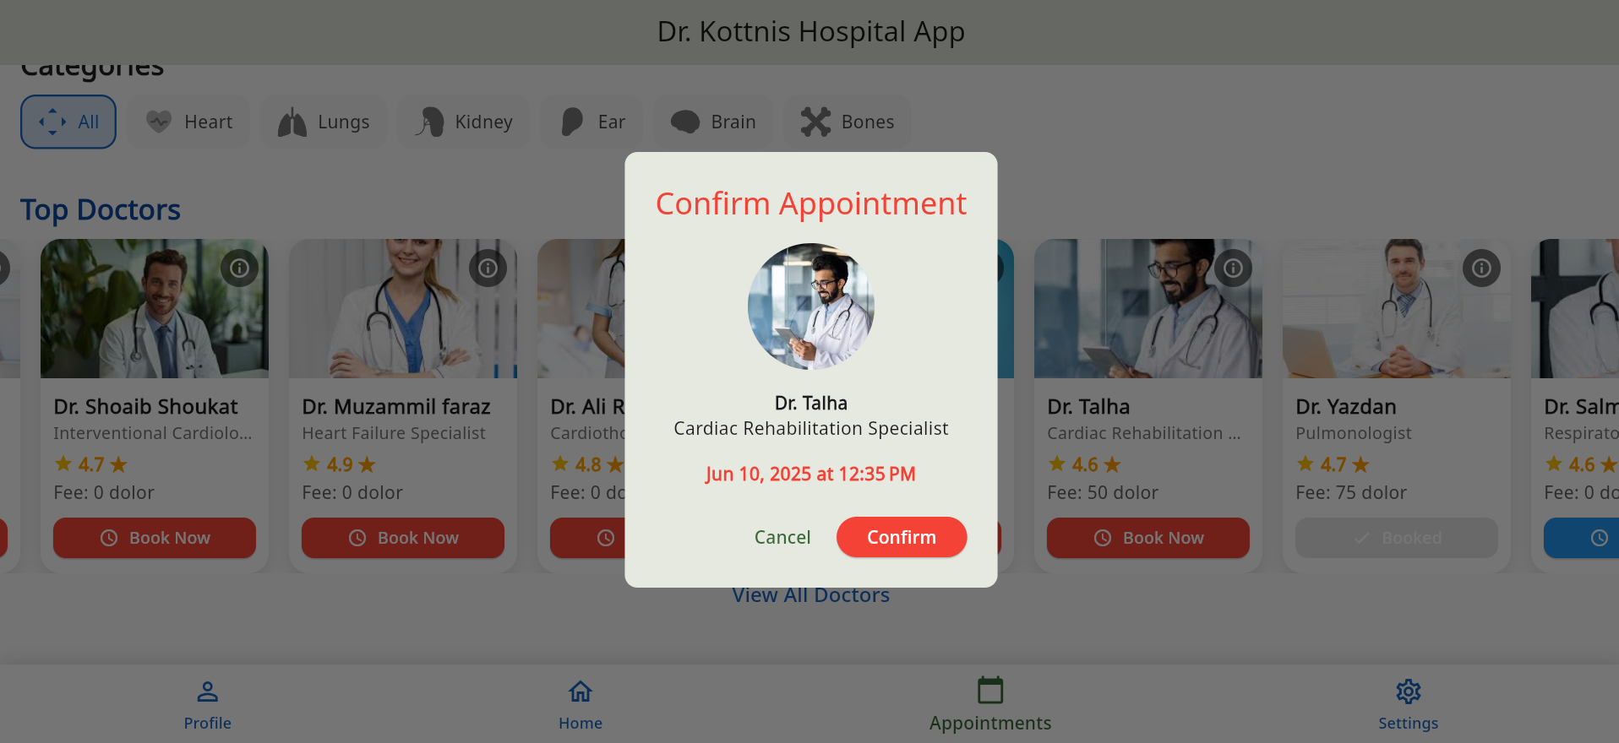
Appoinment booking

Slide 12
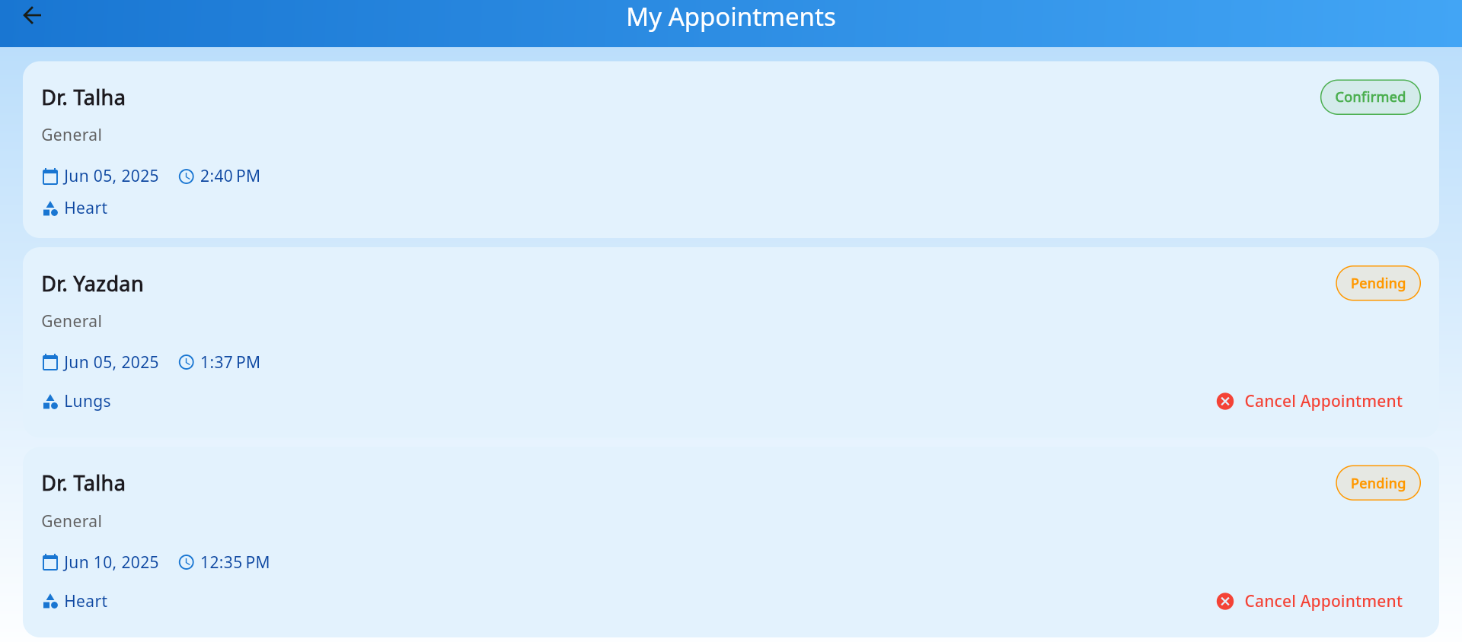
User appointments book successfully wait for doctor response

Slide 13
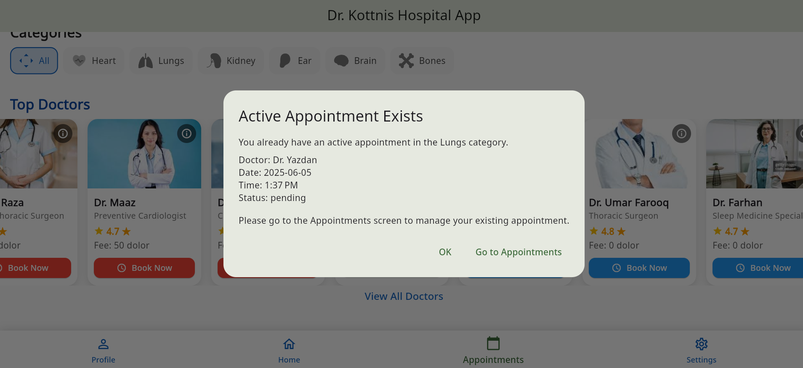
User appointments book 1 apponmnet in 1 category at 1 time wait for doctor response to book other appoinmnet

Slide 14
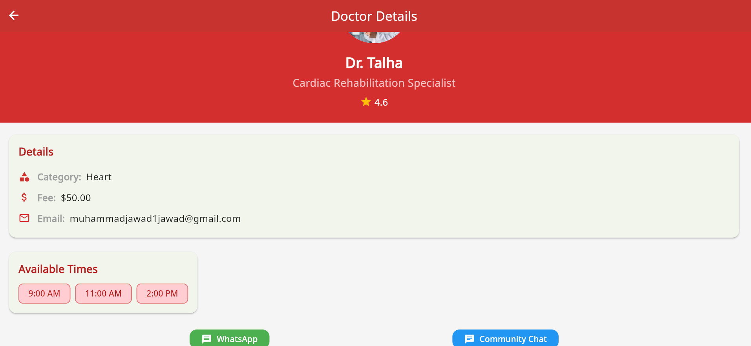
Doctor details screen patient can contact via whatsapp by doctor personally

Slide 15
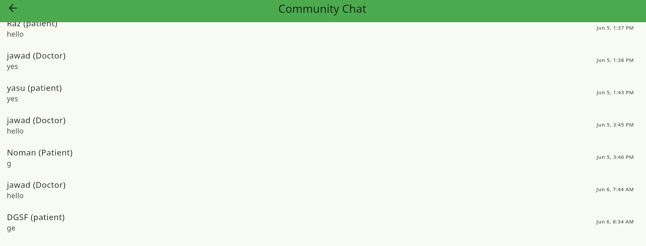
Community chat screen

Slide 16
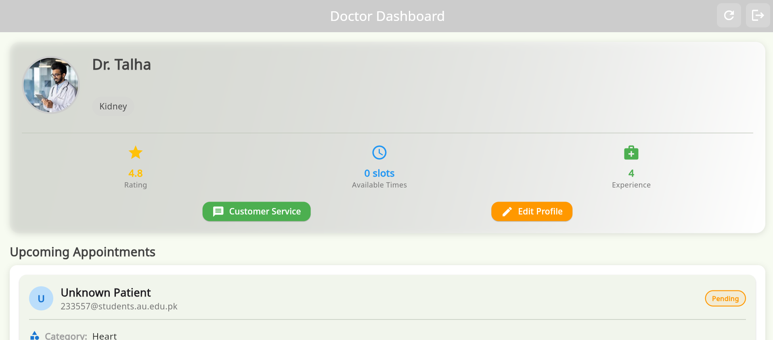
Doctor Dashboard

Slide 17
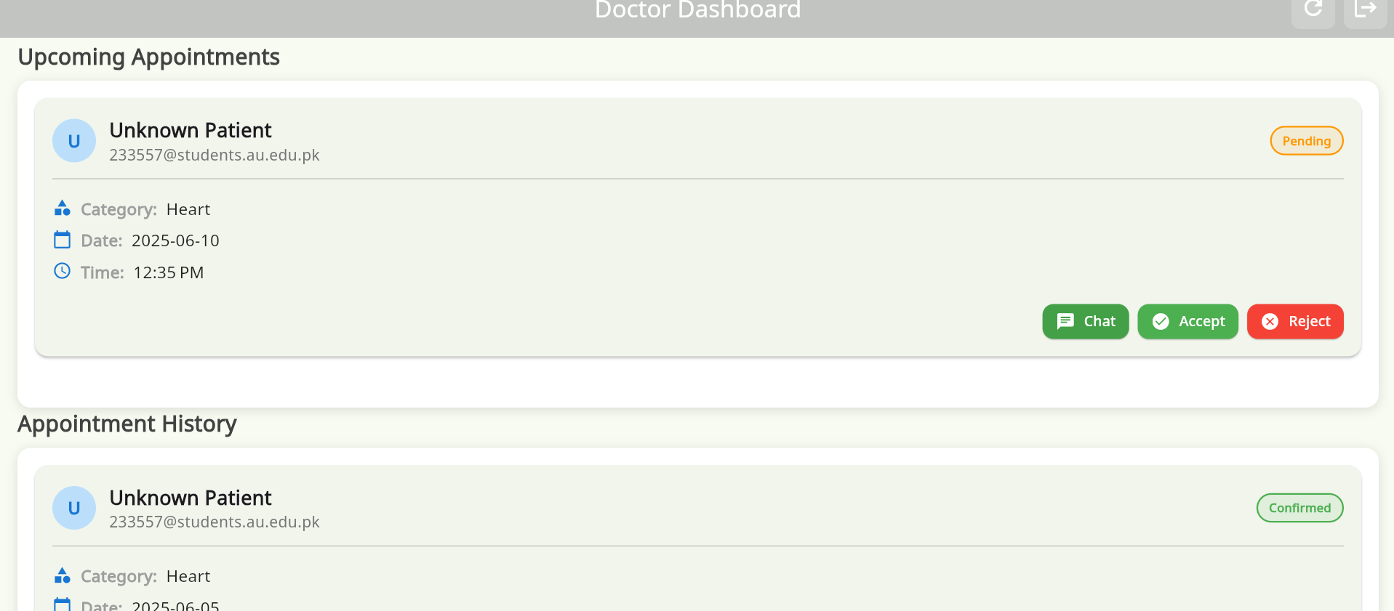
Doctor Appointment screen in which they confirm or cancel the appointment

Slide 18
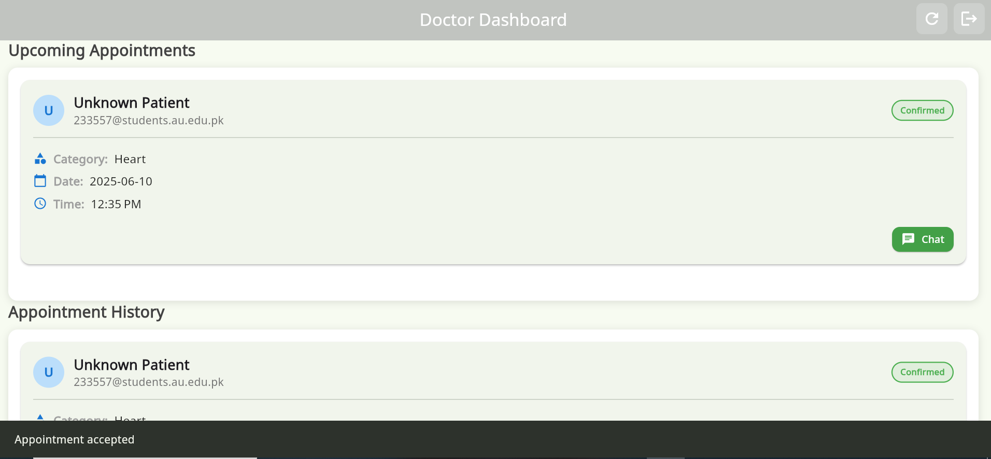
Doctor Appointmentacceoted doctor can see in appoinmnet upcoming after due time it show in appoinmnet history

Slide 19
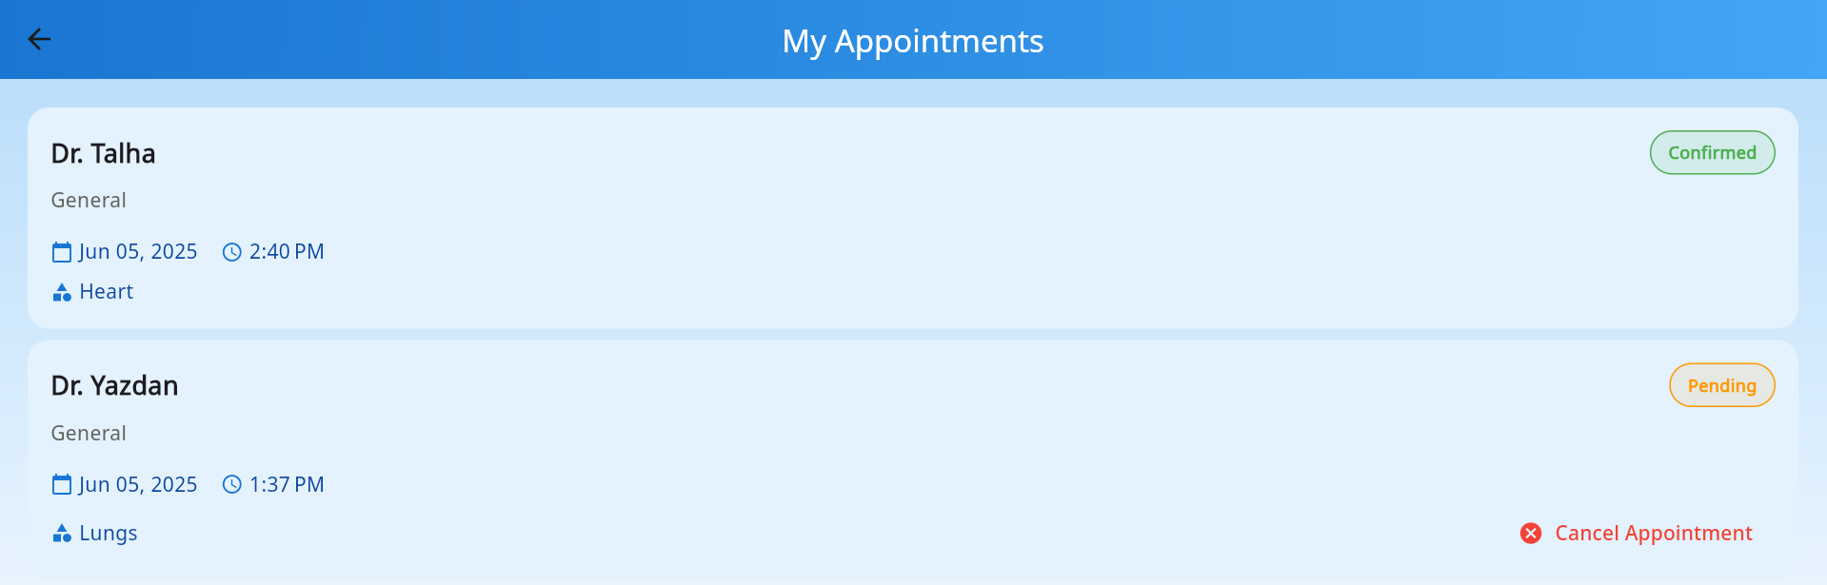
User appoinmnet screen after dr. Talha accepted the appoinmnet show confirm meesage in user appoinmnet

